Slide 1




Marketing Research Process

Slide 2
Recap
Marketing Research Definition
Purpose of Marketing Research
Marketing Research Process
Notes:
Marketing research is the process of gathering and interpreting data for use in developing, implementing, and minoring the firm’s marketing plans (Brown et al., 2018)
Purpose of Marketing research: To link the consumer to the marketer by providing information that can be used in making marketing decisions
Marketing is involved the following process
Specifying what information is need
Gathering the relevant data form internal and external sources
Analyzing and interpreting the data
Communicating the results to the appropriate audiences

Slide 3
Agenda
Chapter 2: Research Process
The first 3 steps of marketing research process (of 11 steps)
Step 1: Establishing the need for Marketing Research
Step 2: Defining the Problem
Step 3: Establishing Research Objectives

Slide 4
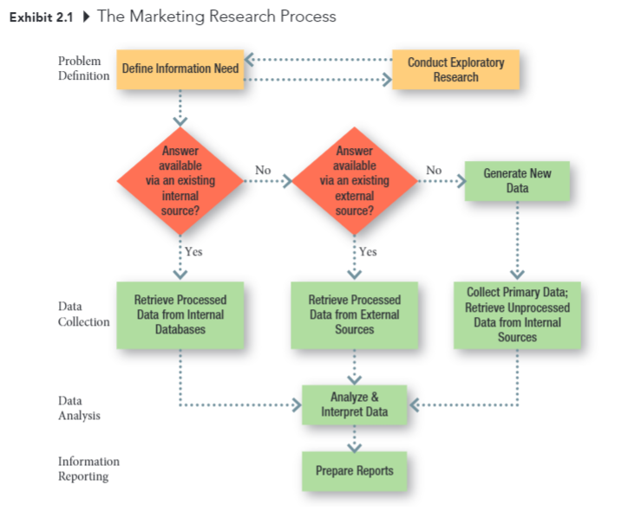
The Marketing Research Proecss

Slide 5
Stage One: Problem Definition (Chapters 3 and 4)
What is the purpose of the study?
Is additional background information necessary?
What is the source of the problem?
Is the research discovery – or strategy- oriented?
What information is need to make the decision?
How much is already known?
Can a hypothesis be formulated?

Slide 6
Stage Two: Data Collection (Chapters 5 to 15)
Can existing data be retrieved form internal sources?
Can existing data be retrieved from external sources?
What is to be measured? How?
What is the source of the data to be collected?
Can observation techniques be used to gather data?
How should observations be taken?
Can objective answer be obtained by asking people?
How should people be questioned?
How should questionnaires be administered?
Should structured or unstructured items be used?
Should the purpose of the study be made known?
What specific behaviors should be recorded?
What criteria define the population? Is a list of population elements available?
Is a probability sample desirable?
How large should the sample be?
Who will gather the data?
How long will the data gathering take?
Notes:
Some key questions:
More specifically, From chapters 5 through 7, we will look at existing data (could be internal or external).
And chapters 8 through 15, we will look at primary data

Slide 7

Data Sources
Existing data from internal sources
Existing data from external sources
New data from individuals or unprocessed data from internal sources

Slide 8
General Approaches to Marketing Research
The collection of data to address specific problems
The development of decision support system that provide marketing intelligence on an ongoing basis
Notes:
The Project Approach (Flashlight)
Collecting data to address specific problems,
The Systems Approach (Candle)
Putting systems in place to provide marketing intelligence on an ongoing basis

Slide 9
Stage Three: Data Analysis (Chapters 16 to 18)
Who will handle the editing of the data?
How will the data be coded?
What analysis techniques will be used?

Slide 10
Stage Four: Information Reporting (Chapters 19 and 20)
Who will read the report?
What is their technical level of sophistication?
What is their involvement with the project?
Are managerial recommendations called for?
What will be the format of the written report?
Is an oral report necessary?
How should the oral report be structured?
Notes:
Today, we go over questions that you can ask yourself when you conduct your semester project.
These questions can help you formulate better understanding of your own research.
You can always go back to these questions later on.

Slide 11
Problem Formulation
Step 1
Meet with Client
Step 2
Clarify Problem/ Opportunity
Step 3
State Manager’s Decisions Problem
Step 4
Develop Full Range of Possible Research Problems
Step 5
Select Research Problem(s)
Step 6
Prepare Research Request Agreement
Notes:
Chapter 3

Slide 12

Step 1: Meet with Client
What is the problem or opportunity you’re facing?
What caused you to notice the problem
Why do you think this situation has occurred?
What is likely to happen if nothing changes in the next 12 months?
Is it likely to be an ongoing problem?
What do you hope to accomplish using marketing research?
What actions ill you take depending upon the answer?
Why?
Notes:
You can use the following questions to probe into the problems versus opportunities that your clients are facing.

Slide 13
Sources of Problems/ Opportunities
Unplanned changes
What has happened? (discovery)
Why has it happened? (discovery)
What should we do about the problem or opportunity? (strategy)
E.g., customers’ complaints about menu
Planned changes
What can happen (discovery)
Why could it happen (discovery) How should we implement the change? (strategy)
E.g., seasonal offerings.
Notes:
There r 2 basic sources of marketing problems: unplanned changes in the marketing environment and (2) planned changes
in environment, serendipity

Slide 14
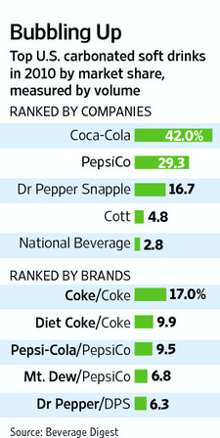
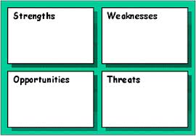
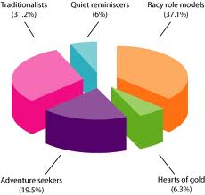
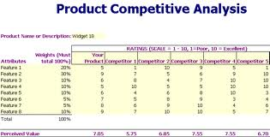
Identify Marketing Opportunities and Problems
Market Demand determination
SWOT Analysis
Competitive Analysis
Market segment identification
Notes:
Some marketing research studies are designed to find out what consumers’ problems are and to assess the suitability of different proposed methods of resolving those problems
Mangers are more likely to always know the symptoms (sales are down, market share is falling), but determining the cause of the symptoms sometimes requires research
Sales are down, but why? What causes it

Slide 15

Step 2: Clarify the Problem/ Opportunity
Reiterate the problem with your clients
Make sure your understanding of the problems match that of your clients
Notes:
One of the most important thing that a research provides a client is a set of “new eyes”
Formulating the true problem or opportunity is often difficult unless you can break away from “Normal” thinking and question assumptions

Slide 16
Step 3: State the Manger’s Decision Problem
Discovery-oriented decision problem
Generating useful information
Strategy-oriented decision problem
Selecting alternative courses of action
Notes:
Decision problem: the problem facing the decision maker for which the research is intended to provide answer:
A well-stated decision problem:
Takes the manger’s perspective
Is as simple as possible
Is stated in the form of a question
Discovery-oriented decision problem: A decision problem that typically seeks to answer what or why questions about a problem/ opportunity. The focus is generally on generating useful information.
Strategy-oriented decision problem: A decision problem that typically seeks to answer how questions about a problem/ opportunity. The focus is generally on selecting alternative courses of action

Slide 17
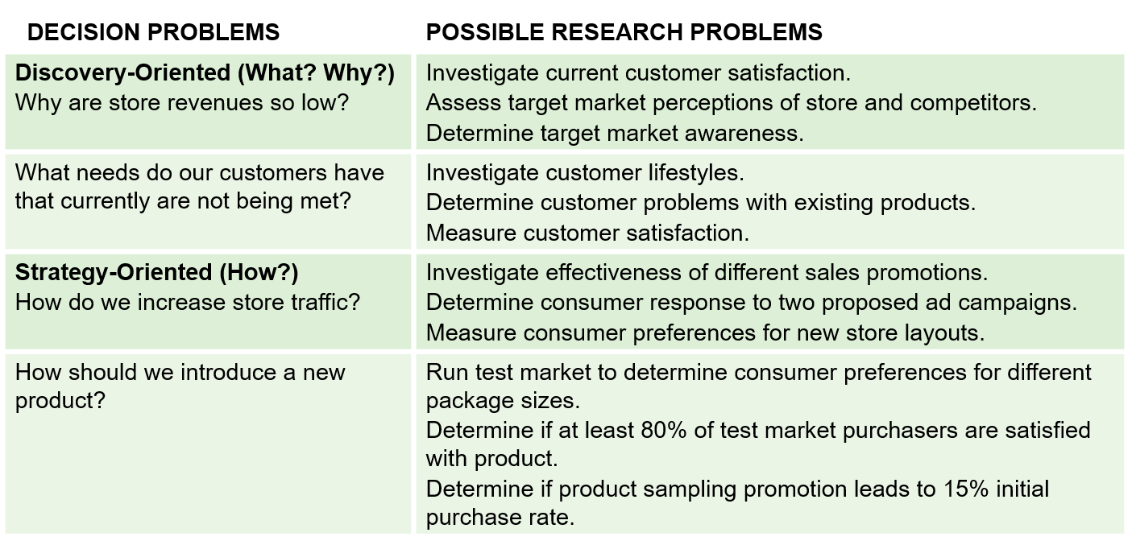
Difference between Decision Problems & Research Problems
Notes:
Resource from Cengage Slide Chapter 3

Slide 18

Step 4: Develop possible Research Problems
Definition: A restatement of the decision problem in research terms.
Investigate current customer satisfaction
Assess Target market perceptions
Determine target market awareness
Notes:
Research Problem: A restatement of the decision problem in research terms.
Investigate current customer satisfaction
Assess Target market perceptions
Determine target market awareness
There will often be MANY research problems associated with a single manager’s decision problem.

Slide 19
Step 5: Select the Research Problem(s) to be Addressed
Trade-off: Value of the information vs. the costs of obtaining it
Notes:
Researchers normally can’t do everything. It is better to address one or two research problems full than to try to do many things at once
trade-off: value of the information be obtained vs. the costs of obtaining it
In a company, you cannot address every problem at the same time. Hence, you typically have to prioritize and decide on which one to focus on.
Similarly, in a semester, you can only achieve so much. Hence, you have to select problem that you can address in this timeframe.

Slide 20

Step 6: Prepare Research Request Agreement
A document prepared by the researcher after meeting with the decision maker that summarizes the problem and the information that is need to address it
Notes:
Research request agreement: A document prepared by the researcher after meeting with the decision maker that summarizes the problem and the information that is need to address it
The purpose of the research request agreement is to make certain that everyone understands the problem to be addressed and what the research is to accomplish
This step is not necessary in the project since it’s student project only.

Slide 21
Sections of a Research Request Agreement
Background
Decision problem
Research problem(s)
Use
Population and subgroups
Logistics

Slide 22
Research Proposal
Research Proposal: A written statement that describes the marketing problem, the purpose of the study, and a detailed outline of the research methodology
The research proposal differs from the research request agreement because it includes the proposed research method and is much more detailed

Slide 23
Research Proposal Outline
A. Problem Definition and Background
B. Research Design and Data Sources
C. Sampling Plan
D. Data Collection Forms
E. Analysis
F. Time Schedule
G. Personnel Requirements and Cost Estimate
H. Appendices

Slide 24


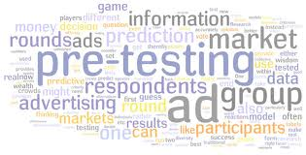
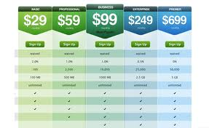
Generating, Refining, and Evaluating Potential Marketing Actions
In-store Promotion
Prototype testing
Advertising pretesting
Pricing test
Notes:
We can think of “actions” as strategies, and strategies involve selecting a target market and designing a marketing mix to satisfy the wants and needs of that target market

Slide 25
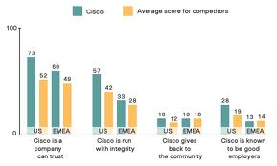



Monitoring Marketing Performance
Tracking studies
Employee Satisfaction
Customer Satisfaction
Pricing test

Slide 26
Marketing Information System
Internal Reports System
Marketing Intelligence System
Marketing Decision Support System (DSS)
Marketing Research System
Notes:
A marketing decision support system (DSS) is defined as collected data that maybe accessed and analyzed using tools and techniques that assist managers in decision making

Slide 27
Recap
Define Marketing Research
Purpose of Marketing Research
Marketing Research Problems
Function of Marketing Research
Marketing Information System

Slide 28
Marketing Research Process

Slide 29
Key Steps in Problem Formulation
Step 1: Meet the Client
Step 2: Clarify Problem/ Opportunity
Step 3: State manager’s Decision Problem
Step 4: develop Full Range of Possible Research Problems
Step 5: Select Research Problem(s)
Step 6: Prepare Research Request Agreement

Slide 30
Steps in Marketing Research Process
Step 1: Establish Need
Step 2: Define a Problem
Step 3: Research Objectives
Step 4: Determine Design
Step 5: Identify Information Sources
Step 6: Decide Data Collection Method
Step 7: Design Questionnaire
Step 8: Determine Sample Plan and Size
Step 9: Collect Data
Step 10: Analyze Data
Step 11: Write and Present Report

Slide 31
Step 1: Establish the Need for Marketing Research
Is there a real need for marketing research?
Research takes time and costs money
Value of information versus the cost of obtaining it
Marketing research is not always needed! Because we might be able to access the information we need cheaper and faster

Slide 32
When Marketing Research is NOT needed?
The information is already available
The timing is wrong to conduct marketing research
Funds are not available for marketing research
Costs outweigh the value of marketing research
Notes:
Or it is not even a marketing research question

Slide 33
Step 2: Define the Problem
Problems are situations calling for managers to make choices among alternatives
Properly defining the problem is the most important step in the marketing research process
Notes:
Stating the Decision Alternatives

Slide 34
The Problem
Managers make decisions because they have a problem. With the right information, managers can choose the correct decision alternative

Slide 35
Is this a problem?
We are losing money
Market share has decreased
No! This is NOT a problem … it is a symptom
Managers must be careful to avoid confusing symptoms with problems
Notes:
Problem is the why and what to do

Slide 36
The Role of Symptoms in Problem Recognition
Symptoms are changes in the level of some key metrics that measures the achievement of an objective (e.g., return on investment, profitability)

Slide 37
Sources of the Problem
Two sources of problems:
A problem exists when a gap exists between what was supposed to happen and what did happen (i.e., failure to meet an objective)
An opportunity occurs when there is a gap between what did happen and what could happen (i.e., opportunity)

Slide 38
Problems and Symptoms
iClicker: which ones are the opportunities?
A: Sales volume below quota
B: Demographic analysis shows rapid increase in population
C: Survey suggest people moving towards “vegan” options
D: Return on investment is below expectation
Notes:
Which one is symptoms vs. cause (- problem/ potential reason of the symptoms)?

Slide 39
Research Objectives
Research objectives are dependent on the “problem” but they are different in that they tell the researcher what he/she must do
Research objectives stated specifically what information will be collected in order allow the manager to select the correct decision alternative
Notes:
doctors vs. mkters: from the judgement of an expert vs. judgement of the consumers / crowd.

Slide 40

Managerial vs. Research Objective
Managerial objective: What the client hope will result from the project (i.e., decision to be made and outcome to be achieved?)
Research objective: What information will help the client to achieve managerial objectives
For example:
Managerial objective: to develop a more effective advertising campaign
Research objective: to determine which media college students are exposed to most frequently, and which media most strongly influence their purchase behaviors
Practice
Managerial objective: Increase number of repeat customers
Research Objective: ?
Notes:
Research objectives: determine current satisfaction and way to improve it.
Management Decision Problem Vs. Marketing Research Problem Management Decision Problem Marketing Research Problem
Should a new product be introduced? Should the advertising campaign be changed? Should the price of the brand be increased? To determine consumer preferences and purchase intentions for the proposed new product. To determine the effectiveness of the current advertising campaign. To determine the price elasticity of demand and the impact on sales and profits of various ICAels of price changes.

Slide 41
Practice Questions
Managerial objective: Increase number of new customers by designing an effective promotion campaign
Research objective: Assess Columbia residents’ awareness and knowledge about a local specialty grocery store that carries international foods

Slide 42
Practice Question
Managerial objective increase number of new customers by adding a new deck for outside dining
Research objective: Identify what features customers desire for the deck

Slide 43
Practice Question
Managerial objective: increase freshmen’s satisfaction with Mizzou orientation procedures.
Research objective:

Slide 44
Research Questions
Questions that managers want to answer
Determine which media is more effective on target audient:
Which social network platform is more effective at reaching 18–25-year-olds in Columbia?
Which social network platform is more effective in driving purchase decision for 18-25 years olds in Columbia?
Determine customer satisfaction and ways to improve it
Overall, how satisfied are customers with the focal store?
How satisfied are the customers with the speed of delivery?
What customers care about the most when they visit our store?
Notes:
Drill further down to
Define customer before 18-25 yr. RO.
Current, if then, why,
Explore first then descriptive
Ads: content, media, audience

Slide 45
Assignment due next class
PA #2 due soon
Case Discussion #1

Slide 46
Recap
Assignment due soon: PA #1

Slide 47
5-min Snippet

